Slide 1



#semanticClimate’s Progress: From being part of hackathons to running them!
Shweata N. Hegde (Volunteer Developer at #semanticClimate; science communicator)
This Photo by Unknown Author is licensed under CC BY

Slide 2

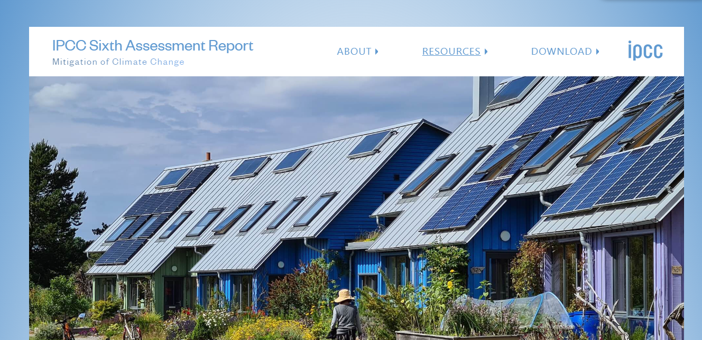
Information to save the world is locked in PDF reports
3000 pages;
technical
not editable
What we do?
IPCC Reports
Citizens are desperate to know this!

Slide 3
Climate Knowledge Explorer for Everyone!
What we do?

Slide 4


Process to make climate facts accessible
Climate-related terms dictionary
pyami
docanalysis
…despite mitigation efforts 8 including those in near-universal nationally determined contributions (NDCs)…
< >
HTML
From PDF to climate fact
What we do?
IPCC chapters,
IPBES reports,
…
Abbreviation dictionary
docanalysis
Shweata N. Hegde, Ayush Garg, Daniel Mietchen, Peter Murray-Rust

Slide 5
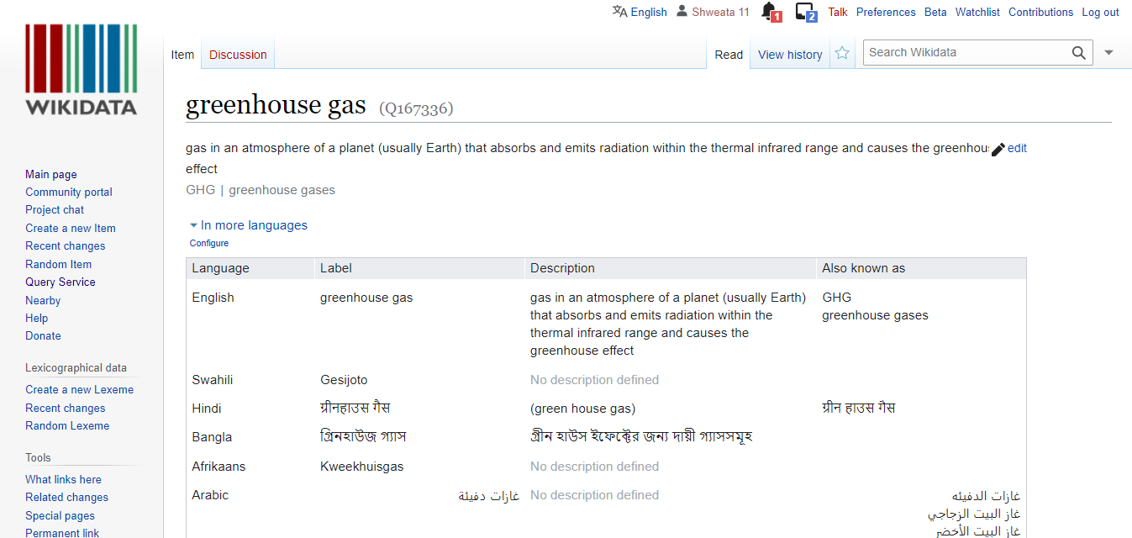
Dictionary
Set of terms with unique Wikidata Identifiers
<entry name="VRE" term="Variable Renewable Energy" wikidataID=“Q7915732”/>
<entry name=“NDC" term=“Nationally Determined Contributions" wikidataID=“Q20051297”/>
<entry name=“GHG" term=“Greenhouse Gas" wikidataID=“Q167336”/>
What we do?
In different languages!

Slide 6
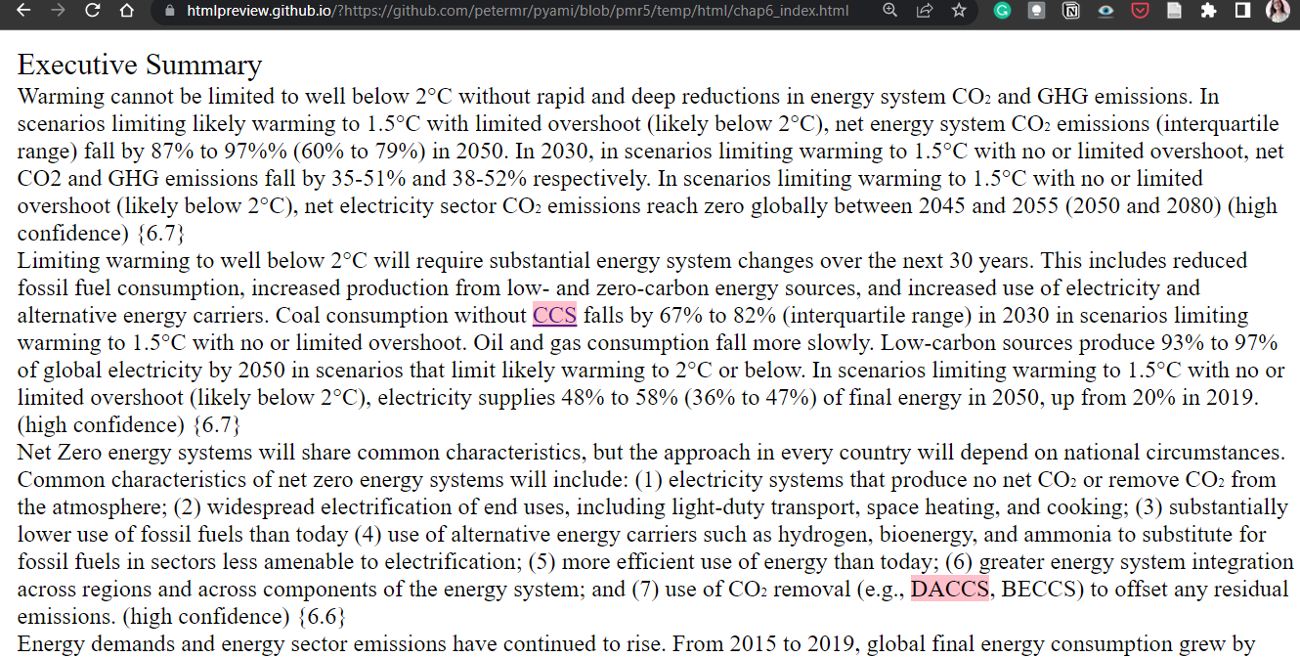
What’s CCS? Look up Wikidata!
What we do?

Slide 7
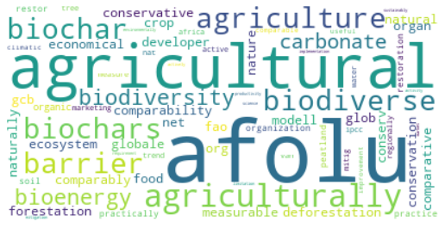
Common terms in chapter?
< >
HTML
Keyword extraction
What we do?
Work by Ananya Singha, Karthikeyan V.

Slide 8
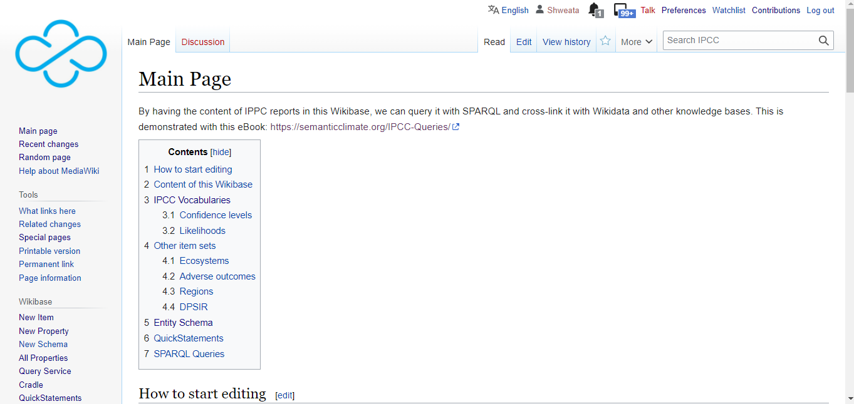
Wikibase: Climate facts accessible to all

Slide 9
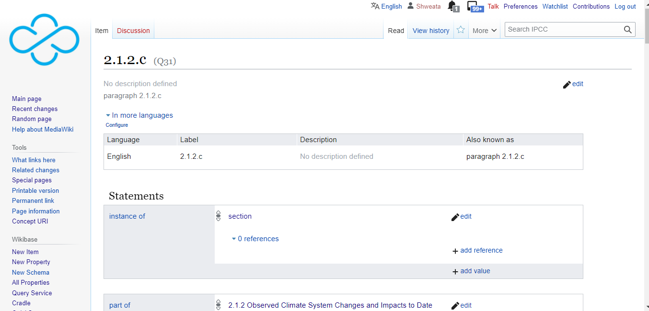
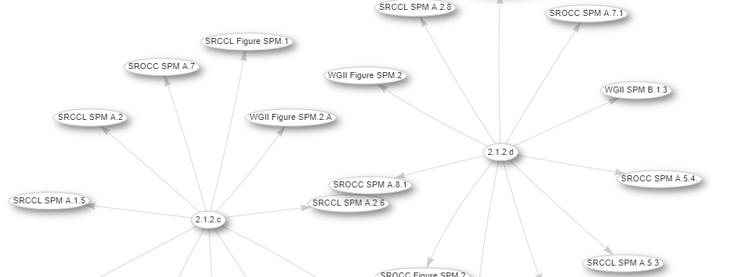
IPCC Knowledge Base

Slide 10
In last year’s (2022) Piaget Hackathon…

Slide 11
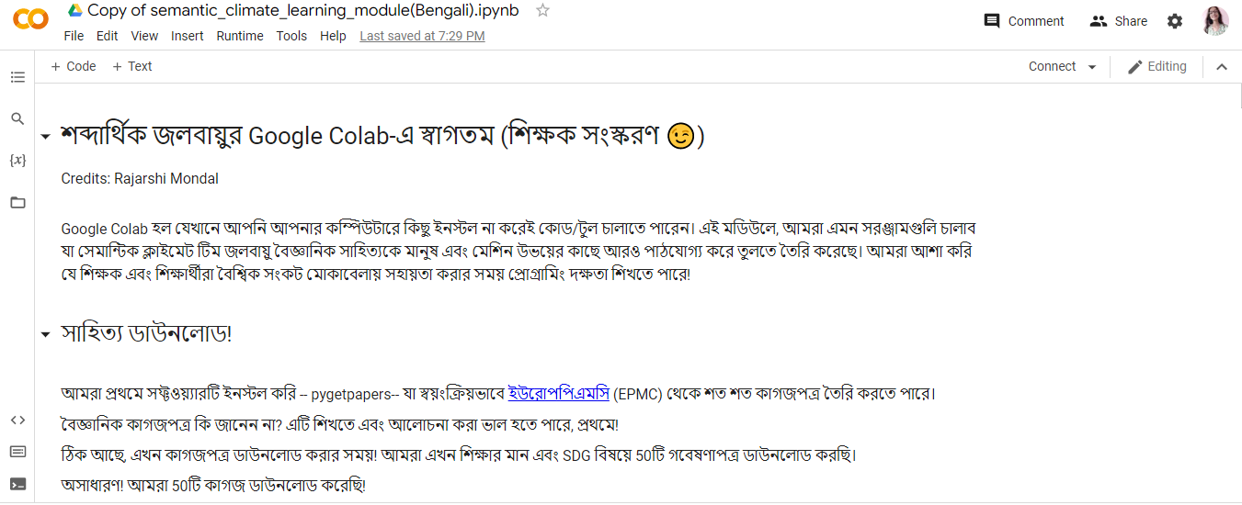
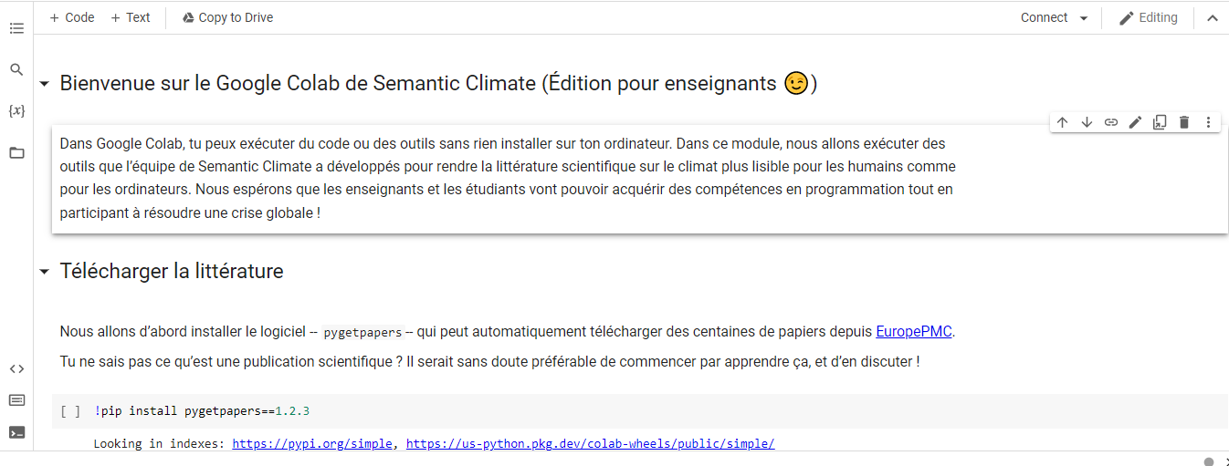
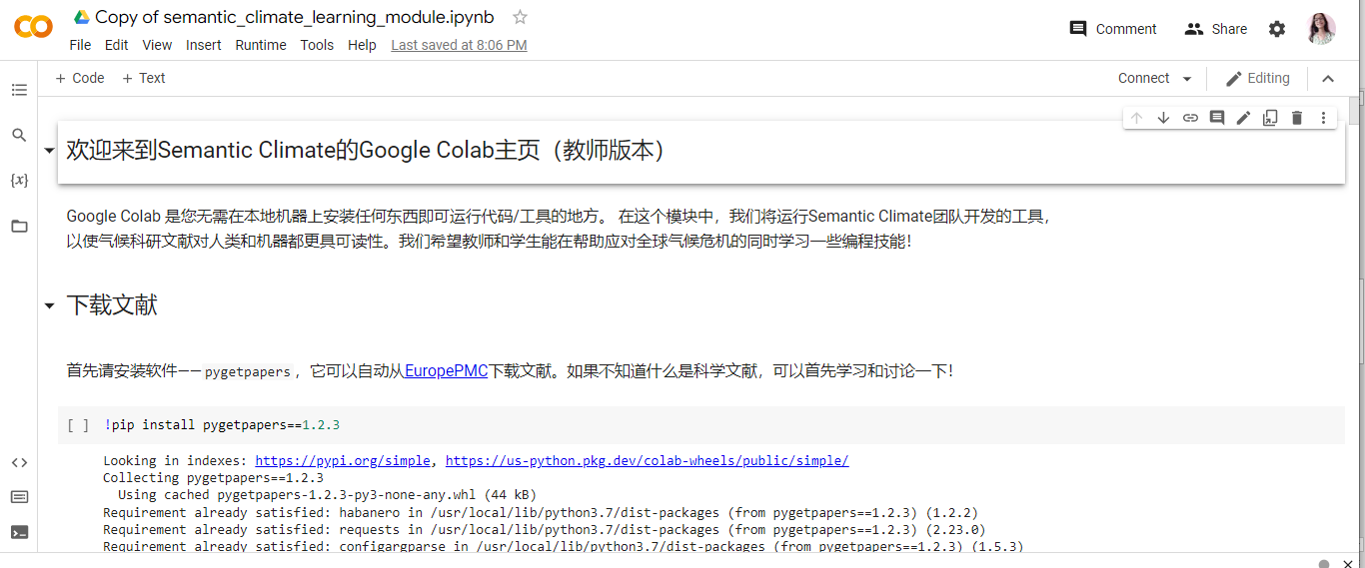
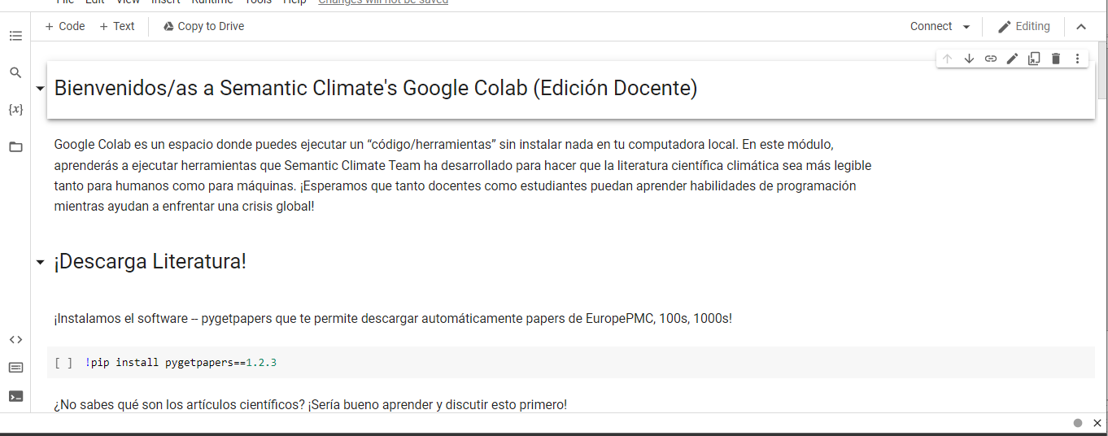
Translated into 6 different languages!
Hindi
Italian
Bengali
French
6 non-programmers ran our code!
#Learning by Doing
Mandarin
Spanish
Notes:
Add more screenshots

Slide 12
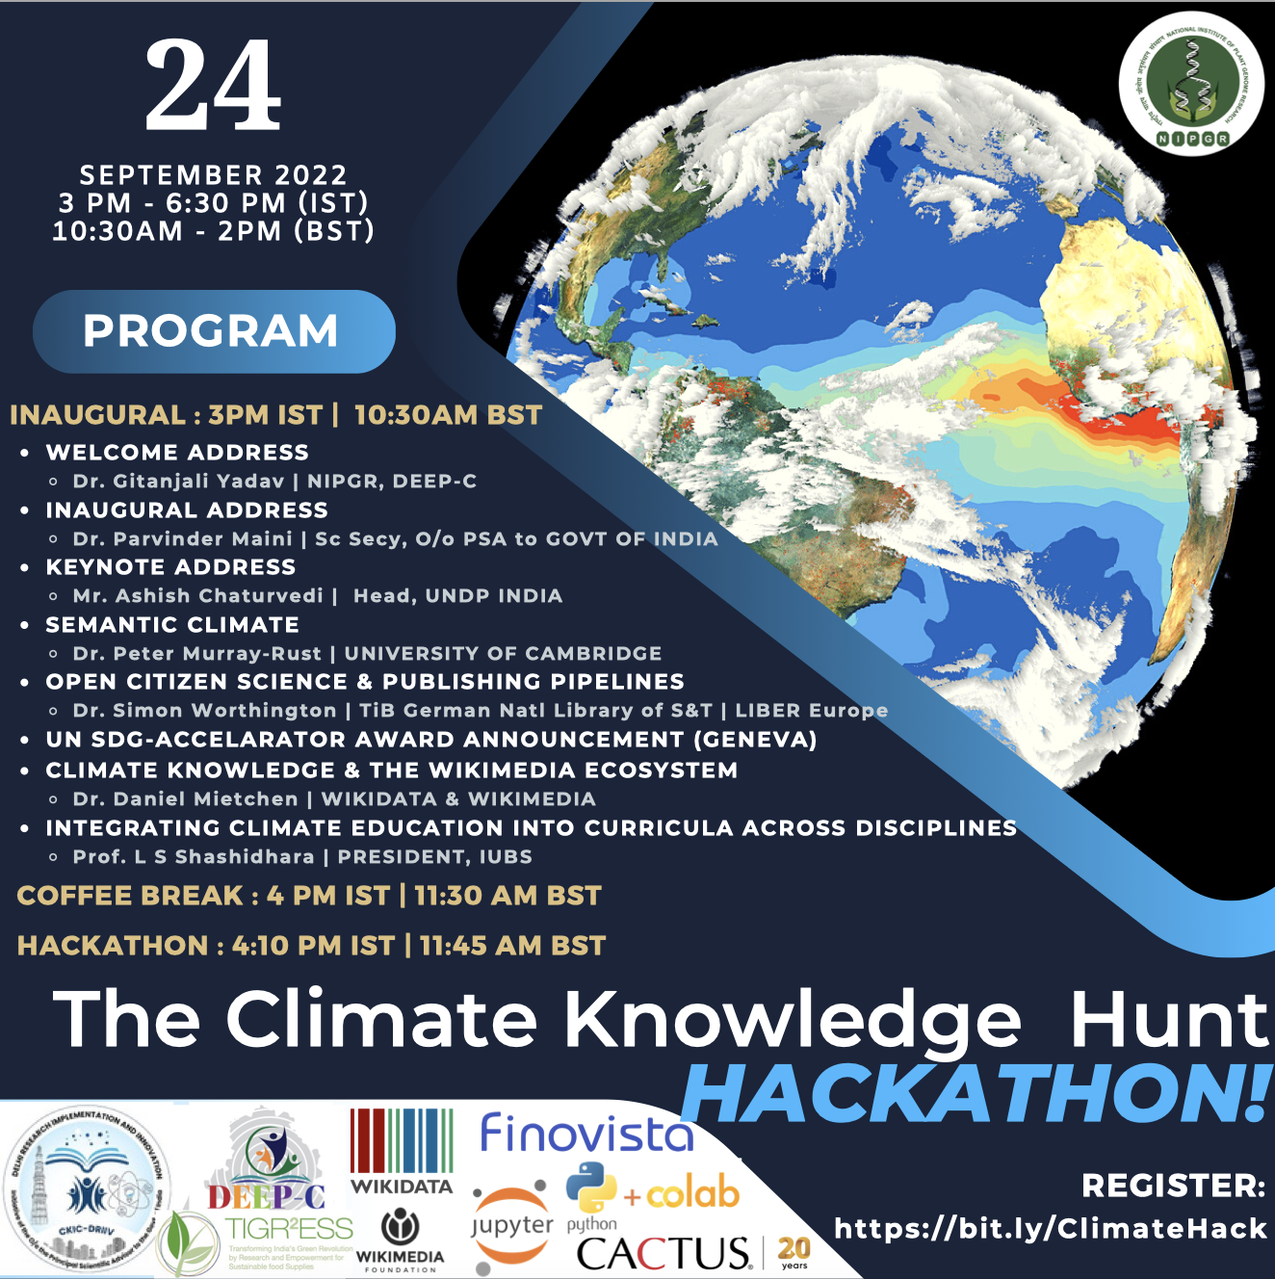
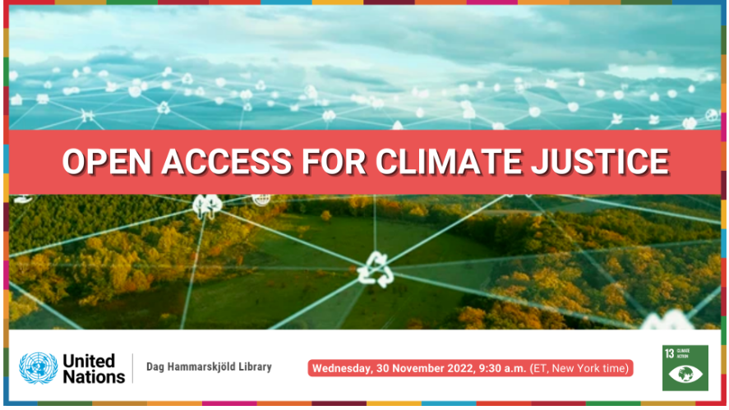
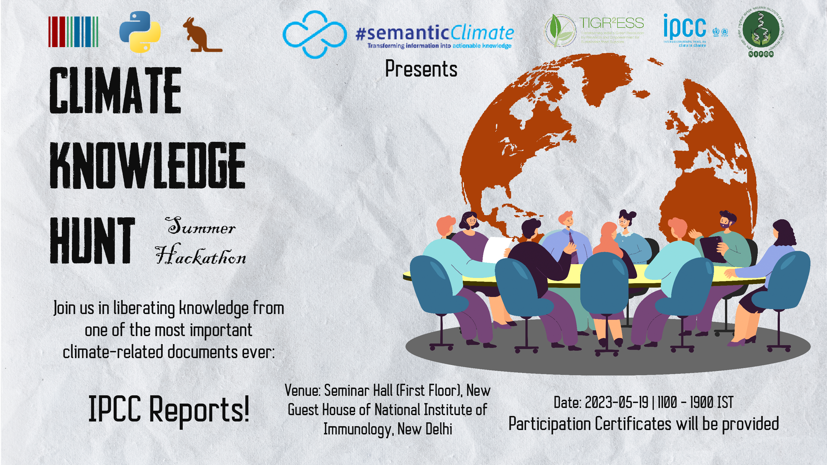
Post Piaget Hackathon
Online Hackathon In Delhi (September 2022)
UN Library (December 2022)
Hybrid Hackathon In Delhi (May 2023)

Slide 13
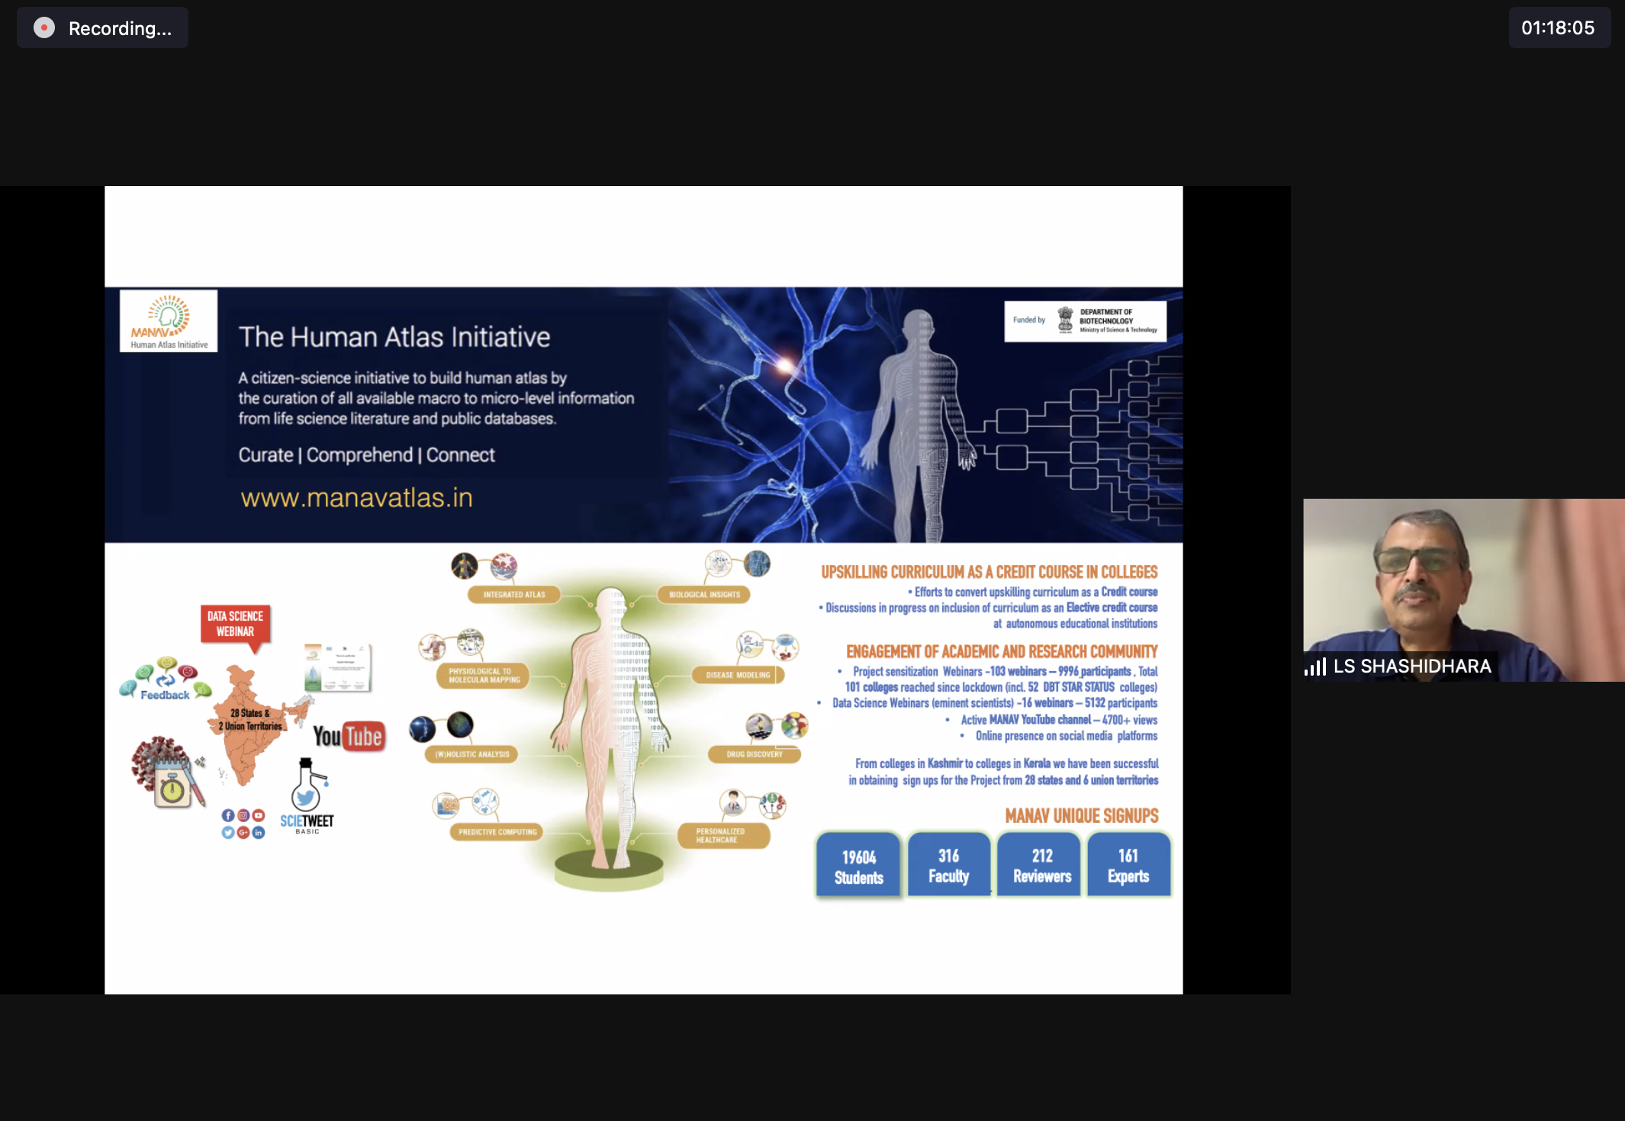
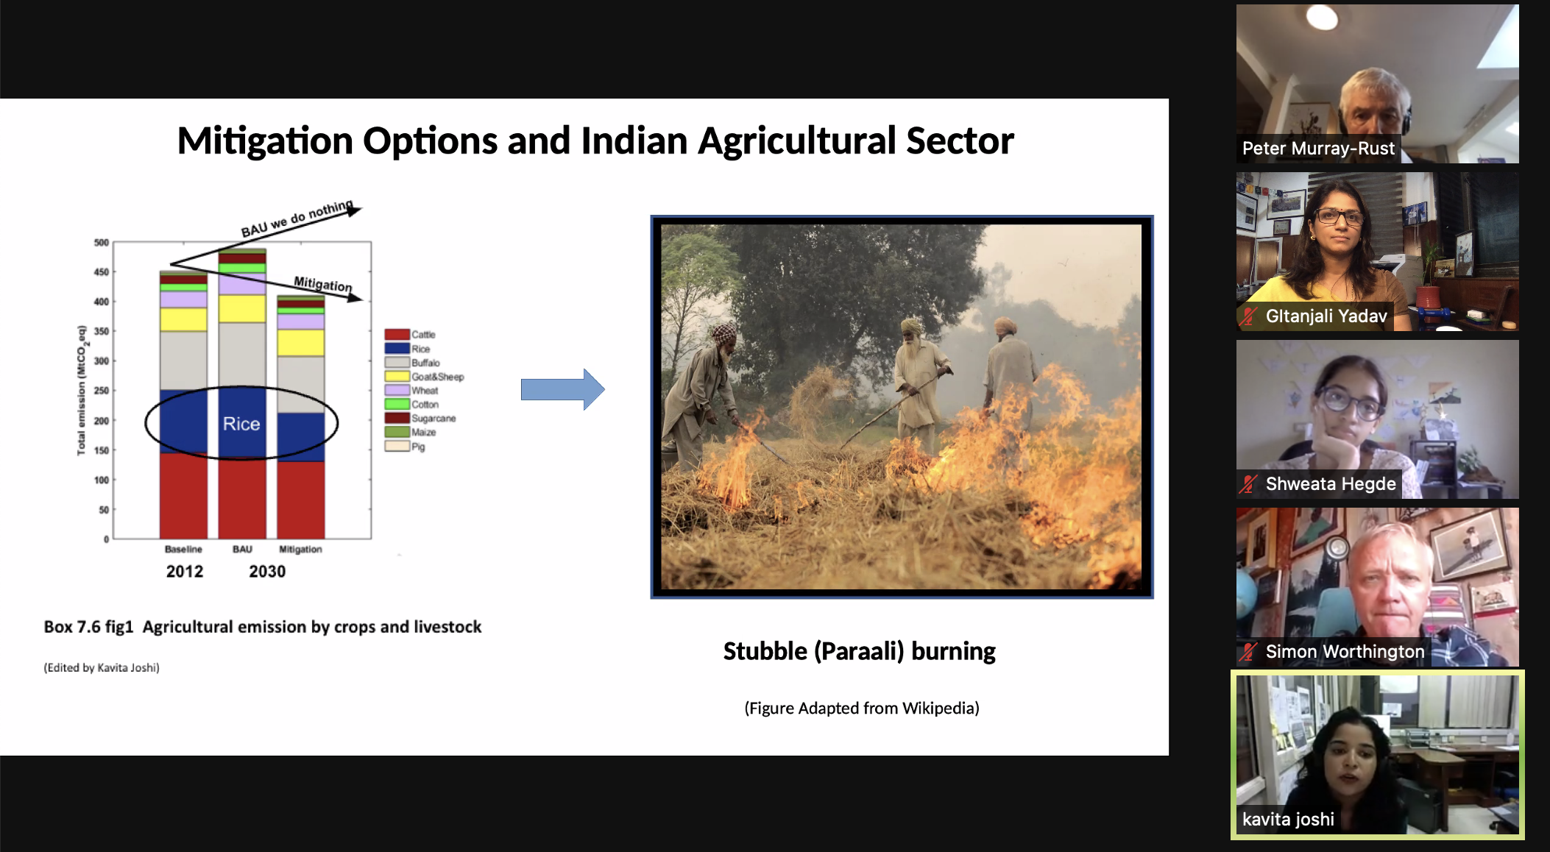
Online Hackathon In Delhi (September 2022)
50 + attendees

Slide 14
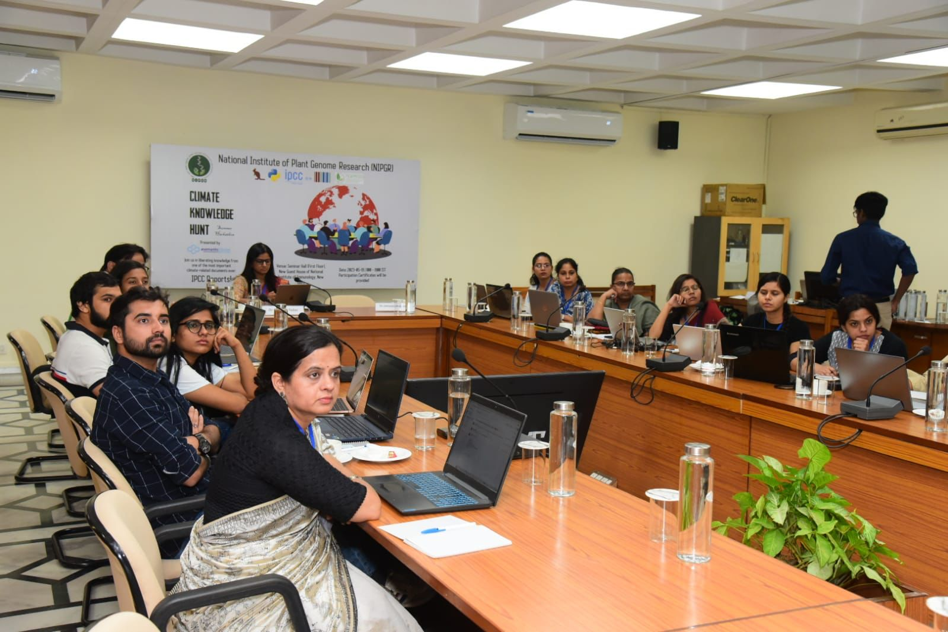
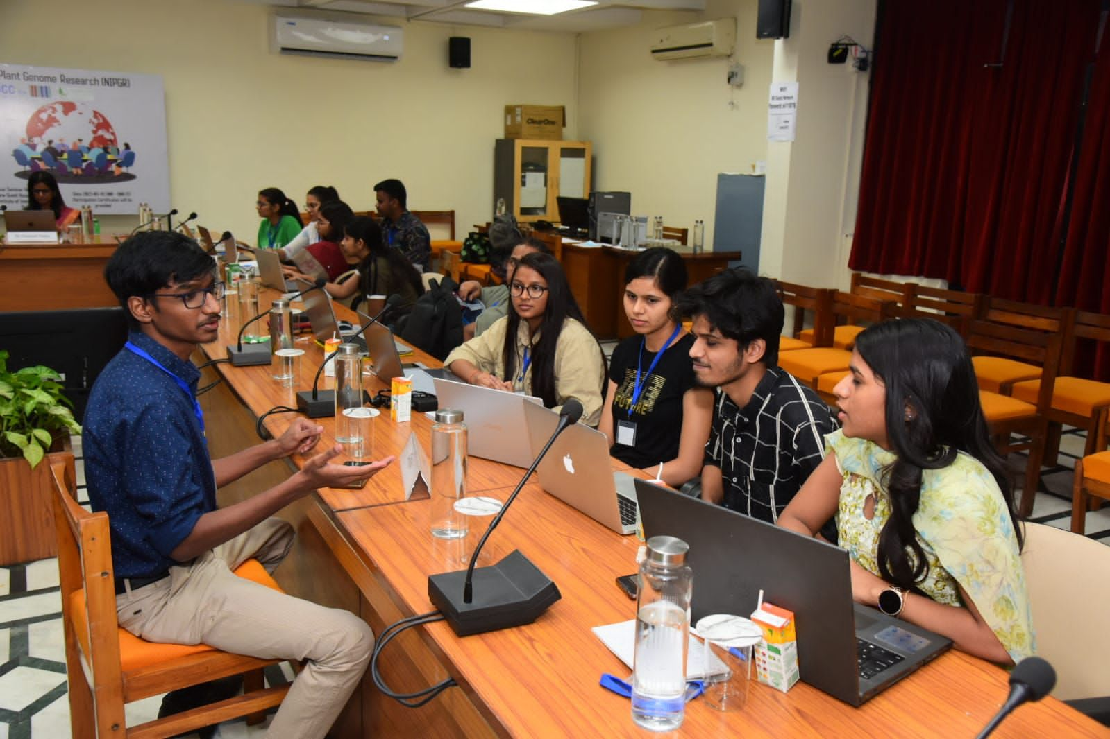
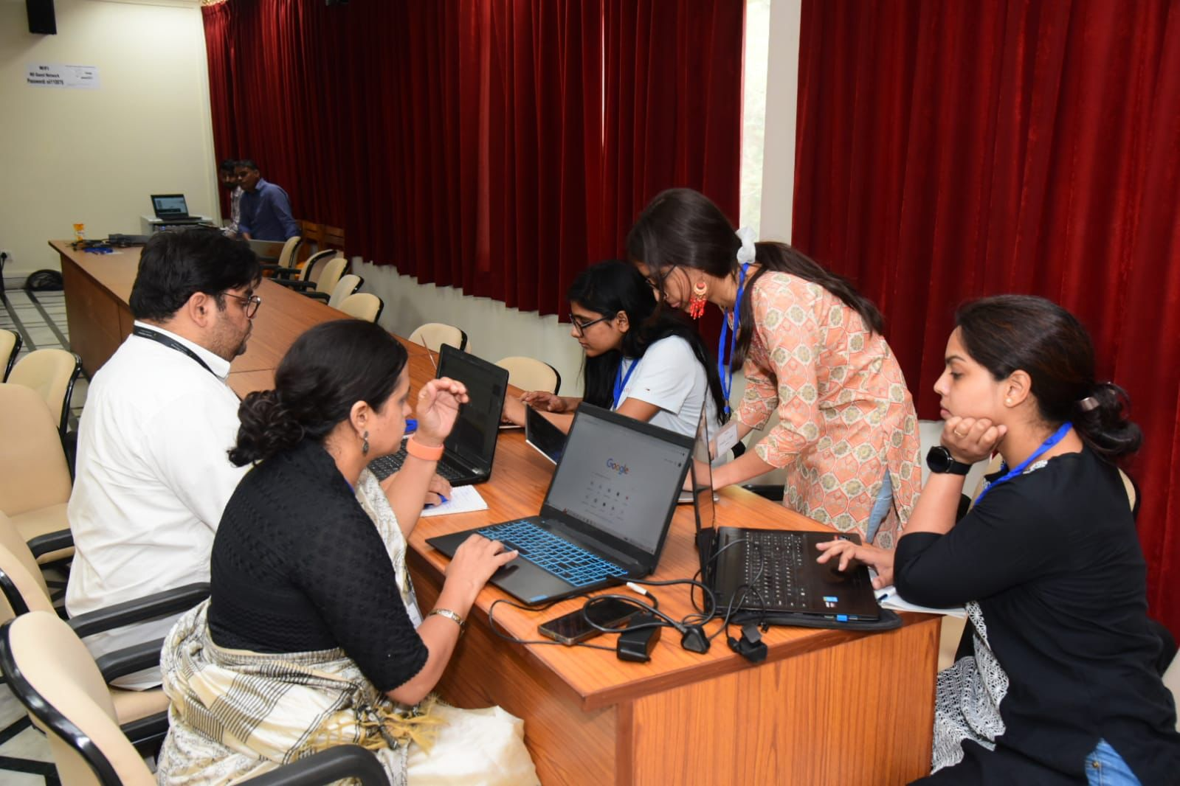
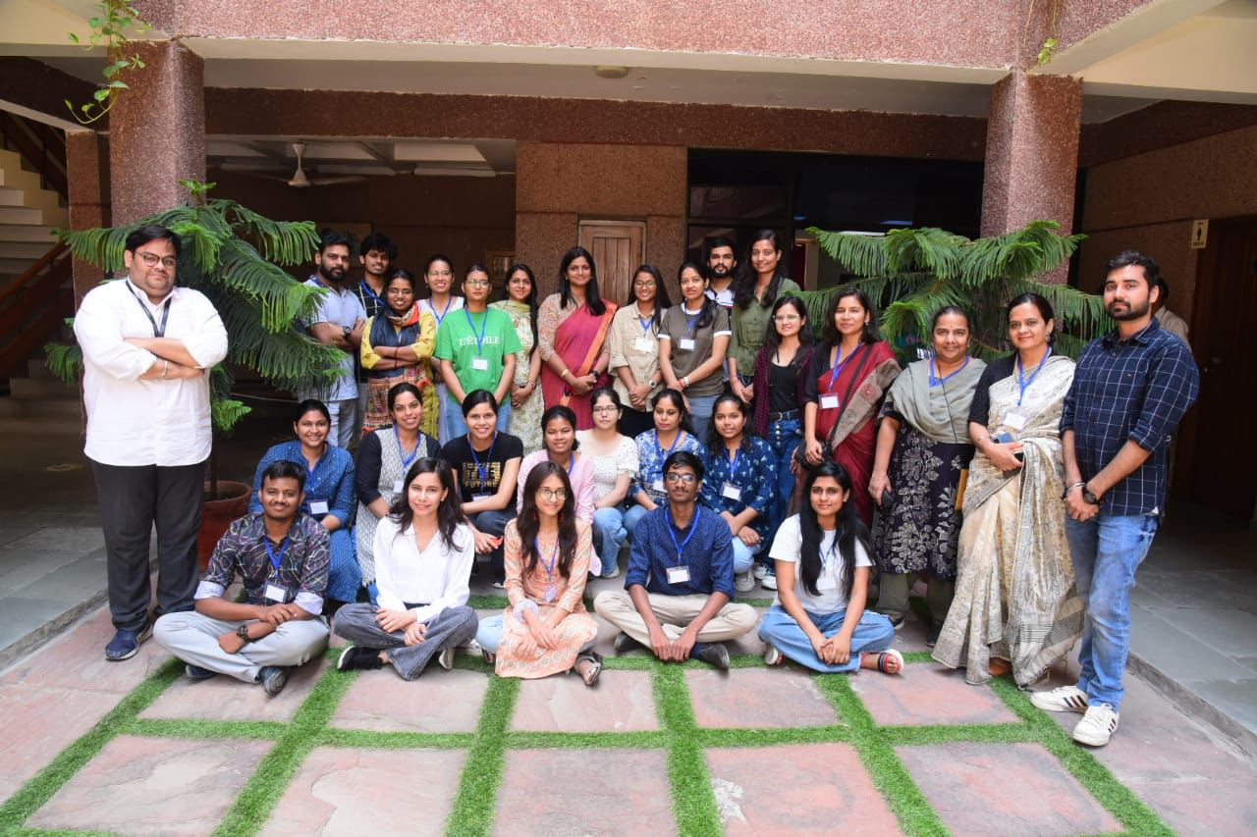
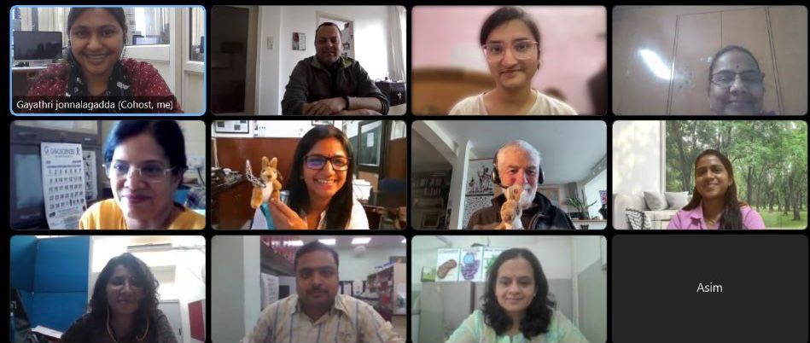
Climate Knowledge Hunt May 2023 (#Learning By Doing) 25 attendees
Notes:
More group pictures (young people!)

Slide 15
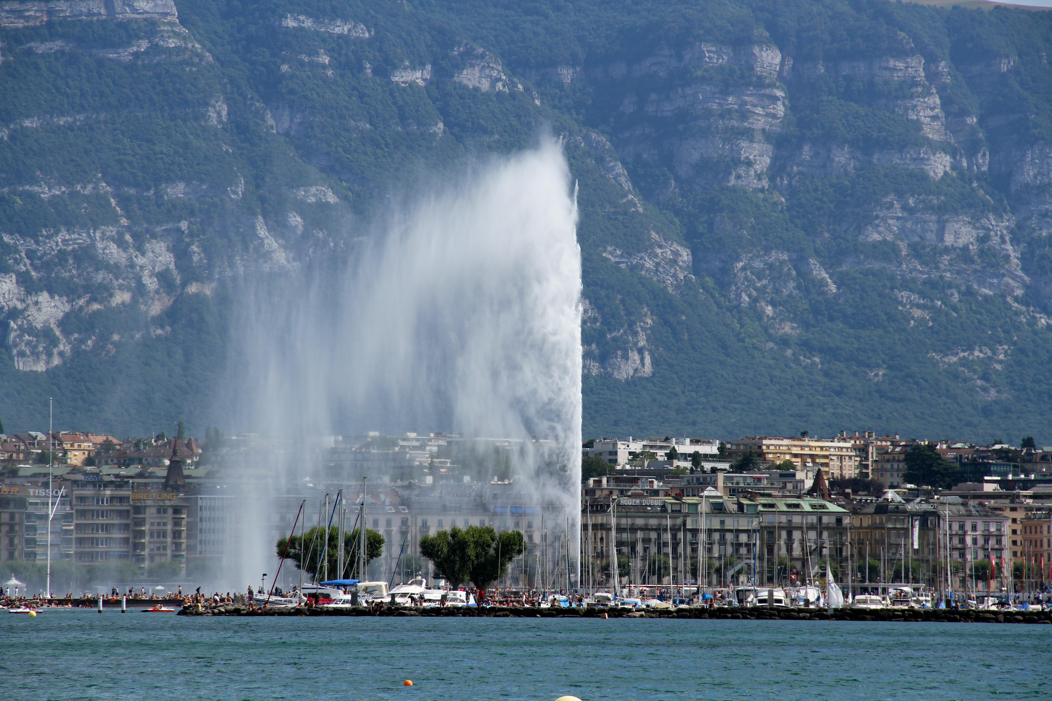
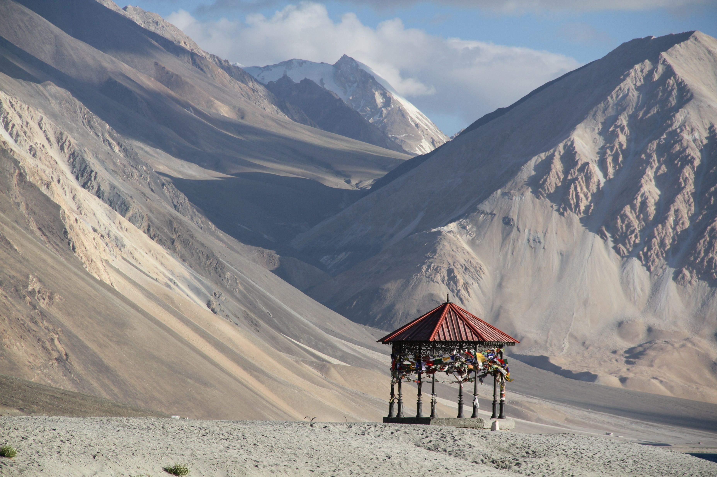
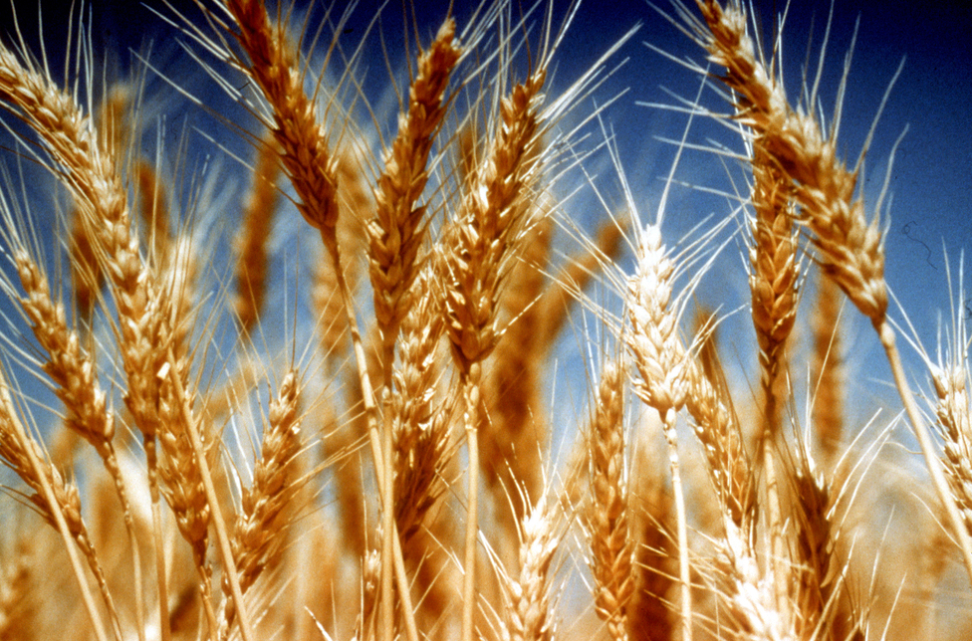
What next?
- Climate Knowledge for Everyone
Cities (IPCC/WG3/Chapter 08)
High mountains (IPCC/SROCC/ Chapter 02)
Food security (IPCC/SRCCL/Chapter 05)
By Lional Rajappa - Own work, CC BY-SA 3.0, https://commons.wikimedia.org/w/index.php?curid=16352290
This Photo by Unknown Author is licensed under CC BY
- Run more events (We are being a part of Climathon (Oct. 2023))
- Building a community!

